Slide 1
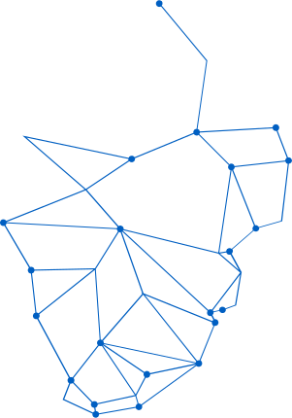

CAPSTONE PROJECT 2
AGENTIC AI
CUSTOMER SUPPORT AGENT
Multi-Agent System for Automated Customer Support
Presented by
SARANIYA DHANSEKARAN

Slide 2

TECHNICAL OVERVIEW
Core Frameworks
• LangGraph for agent workflows
• LangChain for LLM integration
• Streamlit for UI interface
• Key files: app.py, graph.py, rag.py, evaluation_metrics.py & servicenow_client.py
Deployment Options
• Local via Streamlit
• Docker containerization
• Python 3.11+ required
• Scalable architecture
AI Techniques
• Retrieval-Augmented Generation (RAG)
• Multi-agent orchestration
• Automated evaluation pipeline
• ChromaDB vector store
• OpenAI embeddings

Slide 3
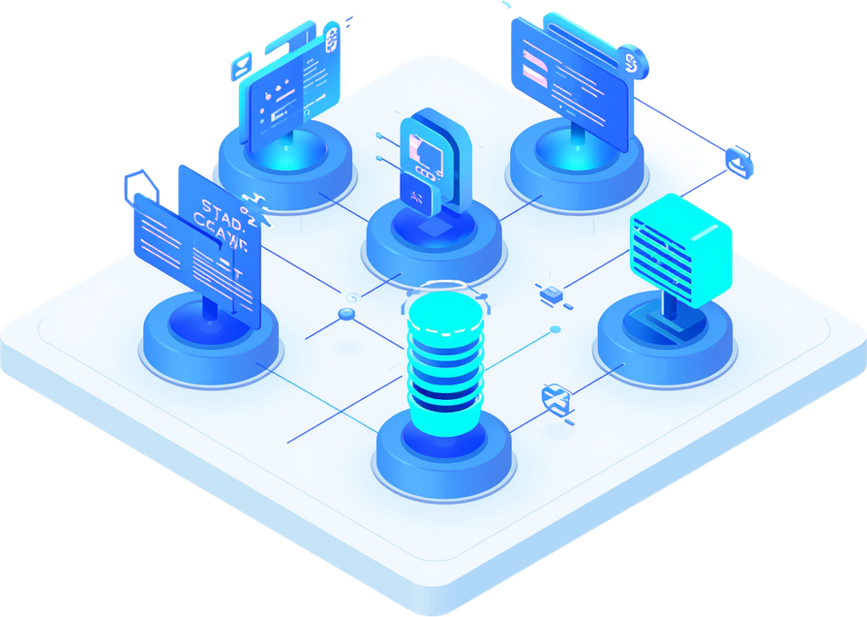
SYSTEM DESIGN
Multi-Agent Architecture Flow:
• Intake Agent → Receives and processes customer queries
• Clarification Agent → Gathers additional context when needed
• RAG Answering Agent → Retrieves knowledge and generates responses
• Summary Agent → Condenses interactions for records
• Routing Agent → Directs tickets to appropriate channels
• ServiceNow Agent → Creates and manages support tickets
Supporting Components:
• ChromaDB vector store with OpenAI embeddings
• Automated evaluation pipeline for quality assurance
• Streamlit interface for real-time interaction

Slide 4
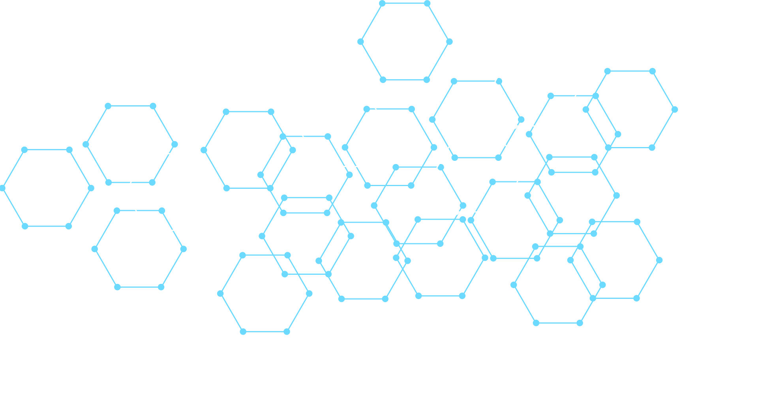
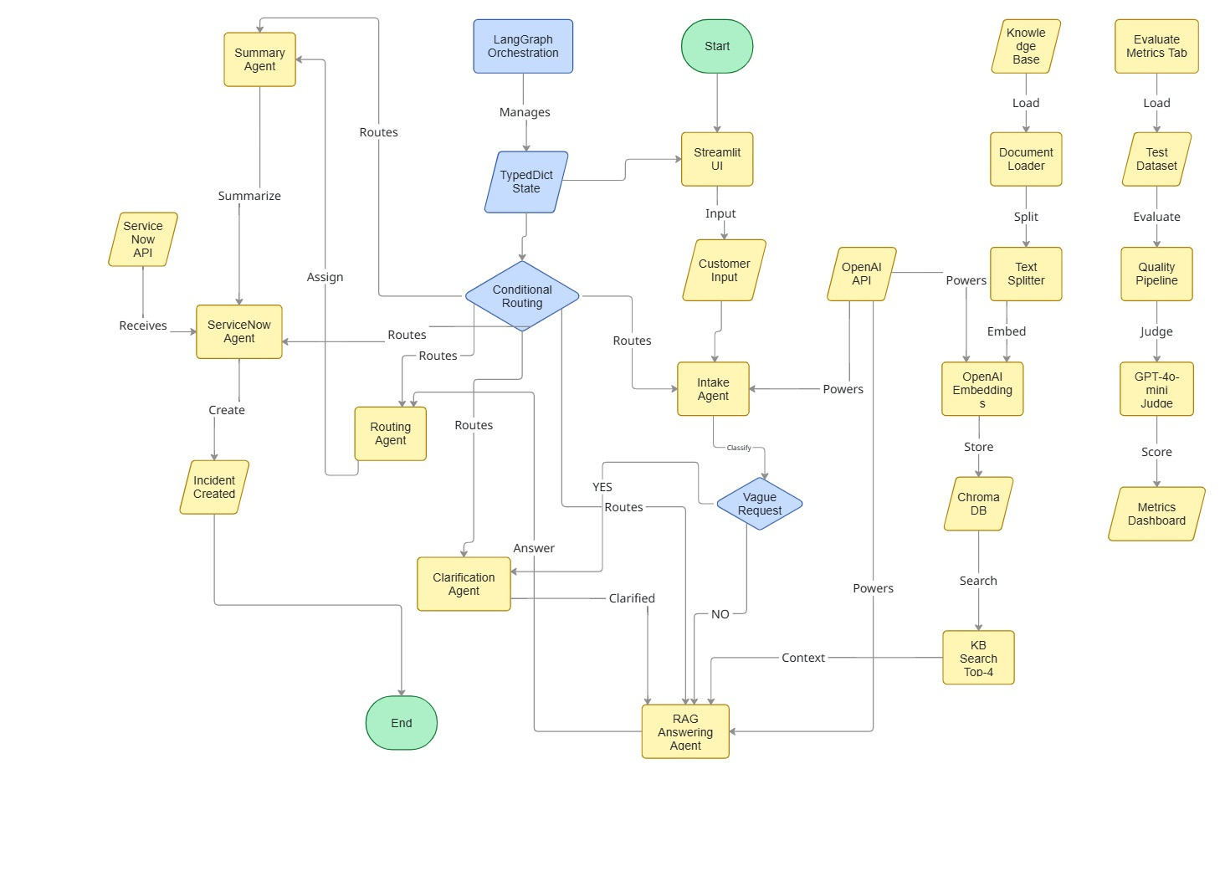
USER WORKFLOW DIAGRAM

Slide 5
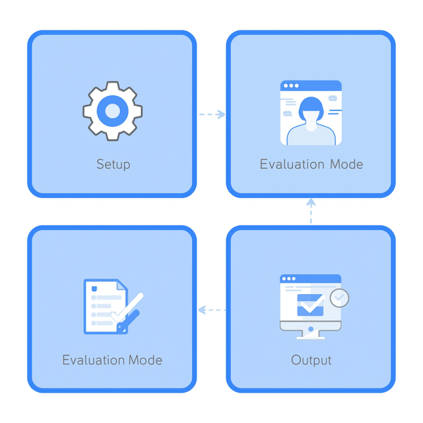

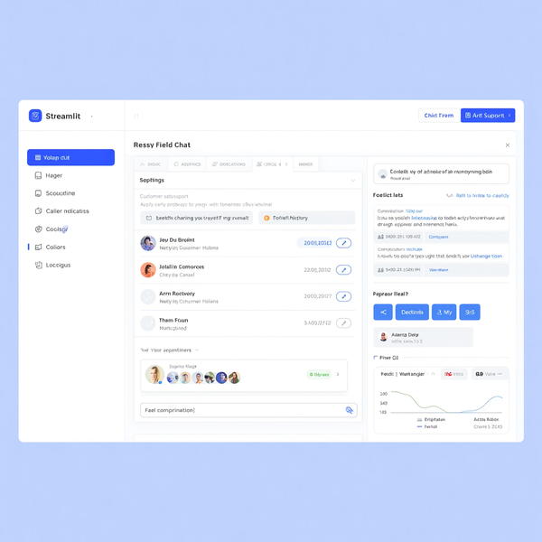
APPLICATION GUIDE
Setup: Configure environment variables, install dependencies (Python 3.11+), and prepare your knowledge base documents. The streamlined setup process gets you running in minutes.
Running Support Agent: Enter customer issues through the Streamlit interface, watch the multi-agent workflow process in real-time, and optionally enable automatic ServiceNow ticket creation.
Evaluation & Output: Run evaluation tests to review quality metrics, view AI-generated responses with summaries and routing recommendations, and receive instant real-time feedback on system performance.

Slide 6
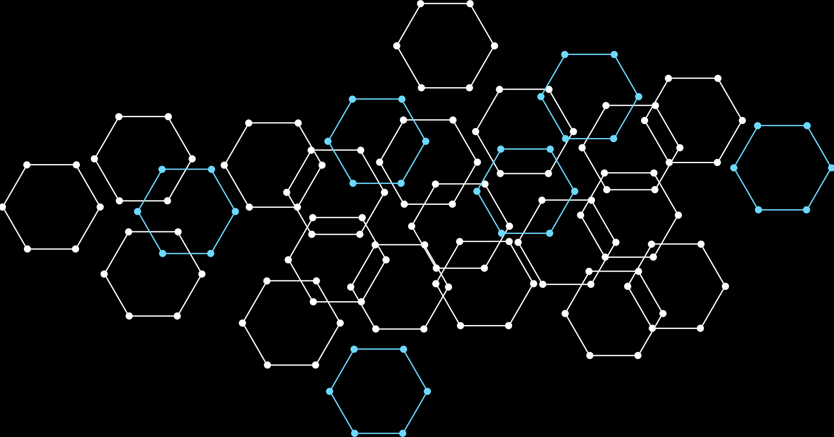



PERFORMANCE METRICS
Answer Quality: 4.2 / 5 — AI-generated responses consistently meet high accuracy standards based on RAG knowledge retrieval and multi-agent validation.
Summary Accuracy: 4.1 / 5 — Automated conversation summaries capture key details with minimal information loss, enabling efficient handoffs.
Ticket Decision: 92% | Routing: 89% | Response Time: <3 seconds, High-precision automation ensures fast, reliable customer support operations.

Slide 7

CUSTOMIZATION OPTIONS
Extend and adapt the system to your needs:
• Add knowledge base documents in data/kb_docs/ to expand AI knowledge
• Modify agent logic in graph.py to customize workflow behavior
• Adjust evaluation criteria in evaluation_metric.py for tailored metrics
• Extend ServiceNow integration for real API calls and ticket management
Agentic AI delivers a scalable, intelligent customer support solution combining cutting-edge AI techniques with flexible deployment options.

Slide 8
QUESTIONS?
Explore the demo at github.com/dsaraniyacse87/customer-support-app.git

